Slide 1
Picking A Singaporean Neighborhood to Live In
Mao Tian Tan

Slide 2
Introduction
Large number of neighborhoods in Singapore
Difficult for foreign tenant to pick neighborhood
Goal: Narrow down the choices by grouping the neighborhoods into clusters.

Slide 3
Data
List of 55 planning areas can be scraped from https://en.wikipedia.org/wiki/Planning Areas of Singapore
Latitudes and longitude of these neighborhoods are obtained from geopy
Use explore query in Foursquare API to obtain venues with 500 meters of these coordinates.
Changing the search radius to 2km has little impact on the analysis.
Create dataframe of venues with the features: neighborhood, neighborhood coordinates, venue name, venue coordinates, venue category

Slide 4
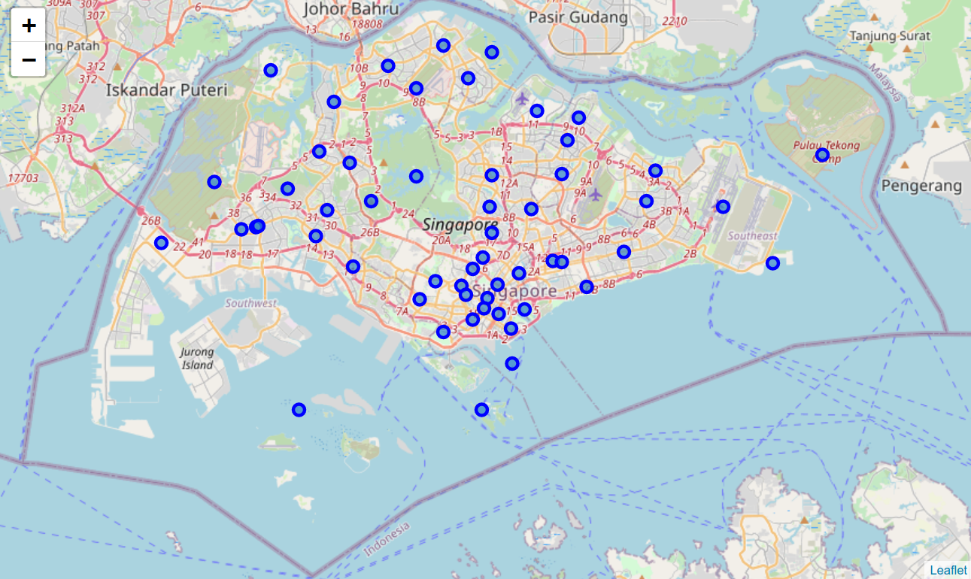
Exploratory Data Analysis
Map of Singapore along with 55 planning areas.

Slide 5
Exploratory Data Analysis
Top five most common venues in Singapore
Rank | Venue Category | Number of venue
1 | Chinese Restaurant | 84
2 | Coffee Shop | 81
3 | Food Court | 71
4 | Japanese Restaurant | 70
5 | Asian Restaurant | 59
These are all in the food and beverage industry. Singapore has a large selection of dining options

Slide 6
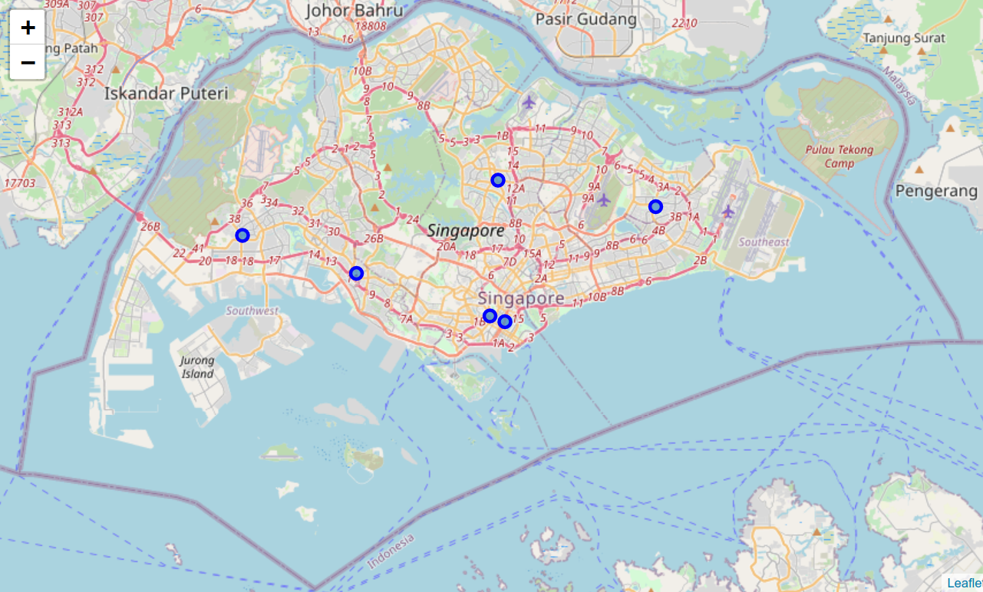
Neighborhoods with Most Gyms
Rank | Neighborhood | Number of Gyms
1 | Tampines | 4
2 | Singapore River | 3
3 | Downtown Core | 3
4 | Ang Mo Kio | 2
5 | Pioneer | 2
6 | Clementi | 2

Slide 7
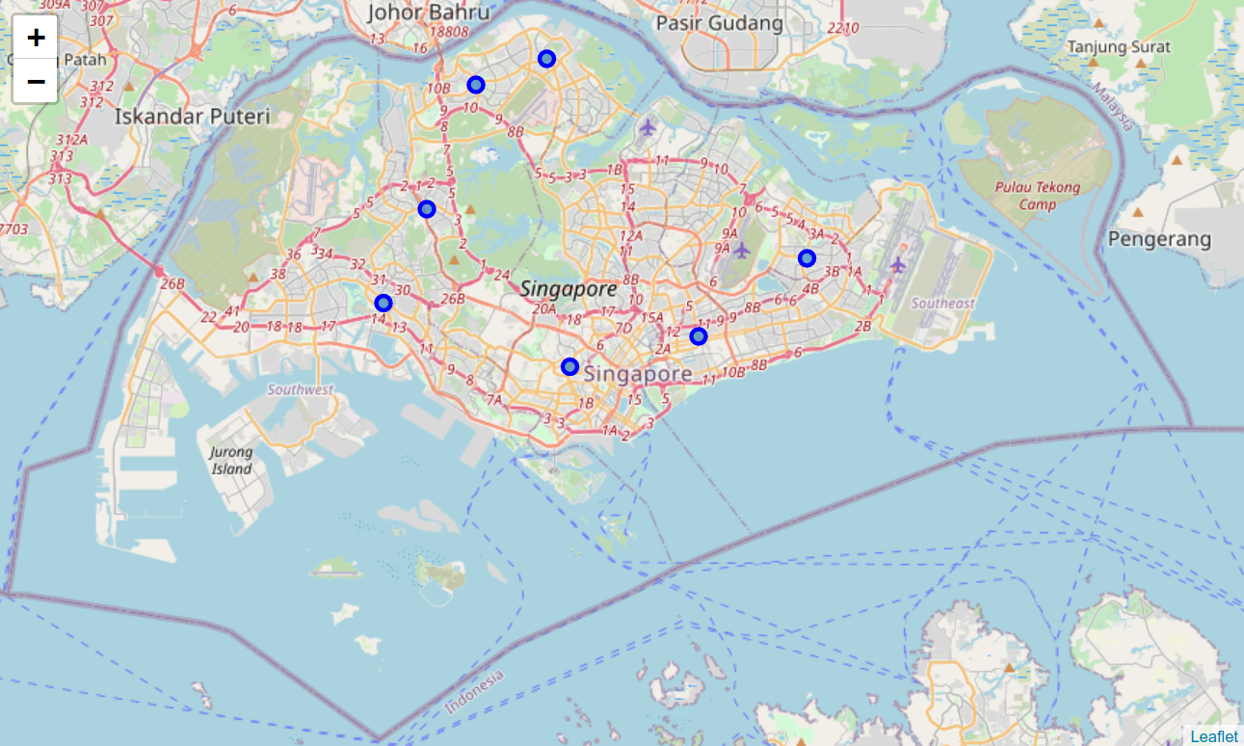
Neighborhoods with Most Malls
Rank | Neighborhood | Number of Malls
1 | Paya Lebar | 6
2 | Orchard | 4
3 | Tampines | 3
4 | Jurong East | 3
5 | Sembawang | 2
6 | Bukit Panjang | 2
7 | Woodlands | 2
8 | Clementi | 2

Slide 8
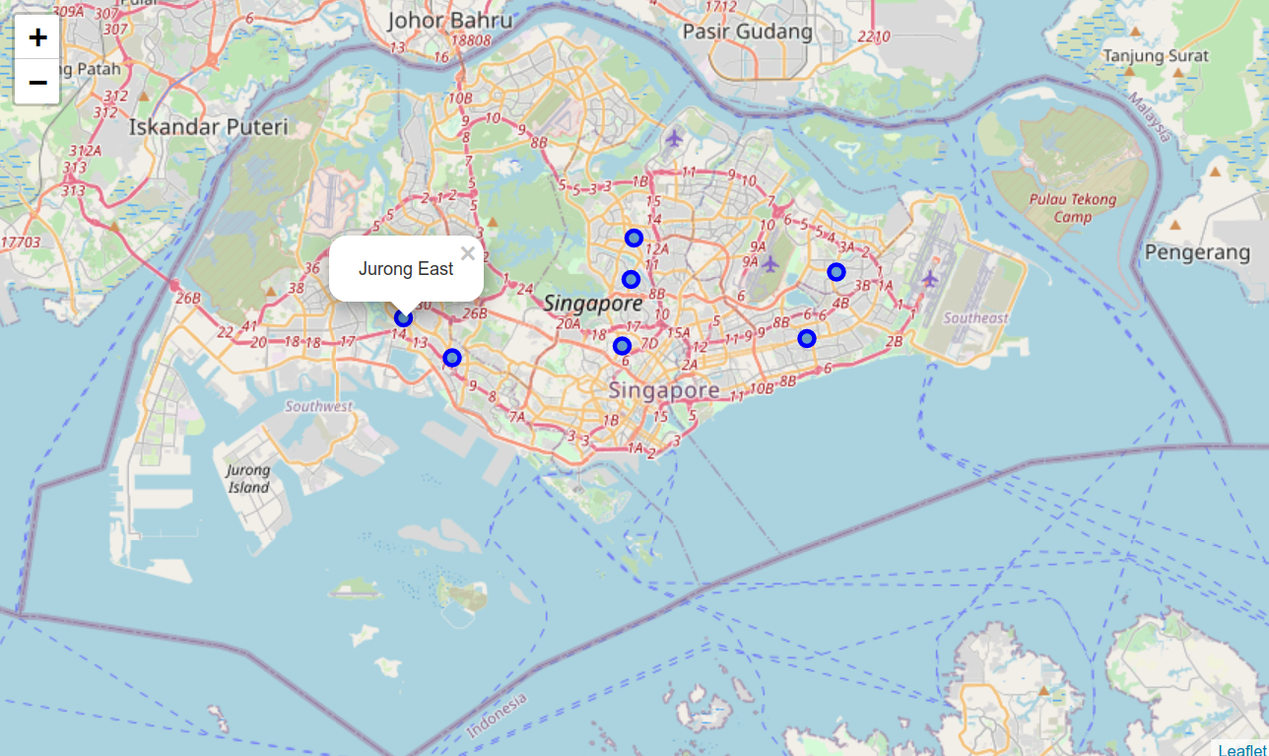
Neighborhoods with Most Coffee Shops
Rank | Neighborhood | Number of Coffee Shops
1 | Novena | 6
2 | Jurong East | 6
3 | Clementi | 6
4 | Bedok | 4
5 | Bishan | 4
6 | Bukit Batok | 4
7 | Ang Mo Kio | 4
8 | Toa Payoh | 4
9 | Tampines | 4

Slide 9
Machine Learning Methodology
Use k-means clustering algorithm to group the neighborhoods into similar groups
First, remove the outlier neighborhoods that are not residential district, resulting in 34 remaining neighborhoods.
Grouping into five clusters results in a more even distribution of neighborhoods over the clusters.

Slide 10
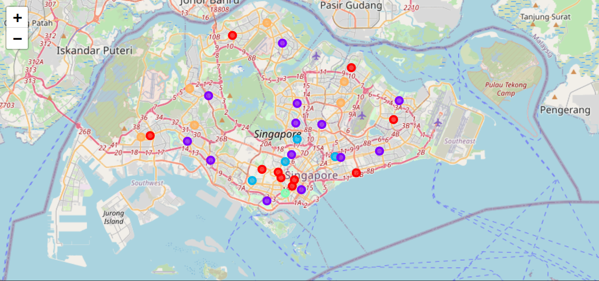
Results

Slide 11
Results
Top five most common venues (taking into account ties) along with the number of such venues in each cluster.

Slide 12
Results
The five clusters of neighborhoods have distinct flavors
Cluster | Neighborhoods
0 | Boon Lay, Marine Parade, Museum, Orchard, Punggol, River valley, Singapore River, Tampines, Tanglin, Woodlands | Exciting
1 | Ang Mo Kio, Bedok, Bishan. Bukit Merah, Bukit Panjang, Clementi, Downtown Core, Jurong East, Novena, Pasir Ris, Paya Lebar, Serangoon, Yishun | Regular
2 | Geylang, Newton, Queenstown, Toa Payoh | Central and ungentrified
3 | Outram | Unique
4 | Bukit Batok, Choa Chu Kang, Hougang, Pioneer, Sembawang, Senkang | Far from central and ungentrified

Slide 13
Conclusion
Divided 34 Singaporean neighborhoods into 5 clusters.
K-mean clustering worked well in identifying clusters with distinct flavors
Potential tenants can narrow down their choice of neighborhoods based on preferences and budget

